Slide 1
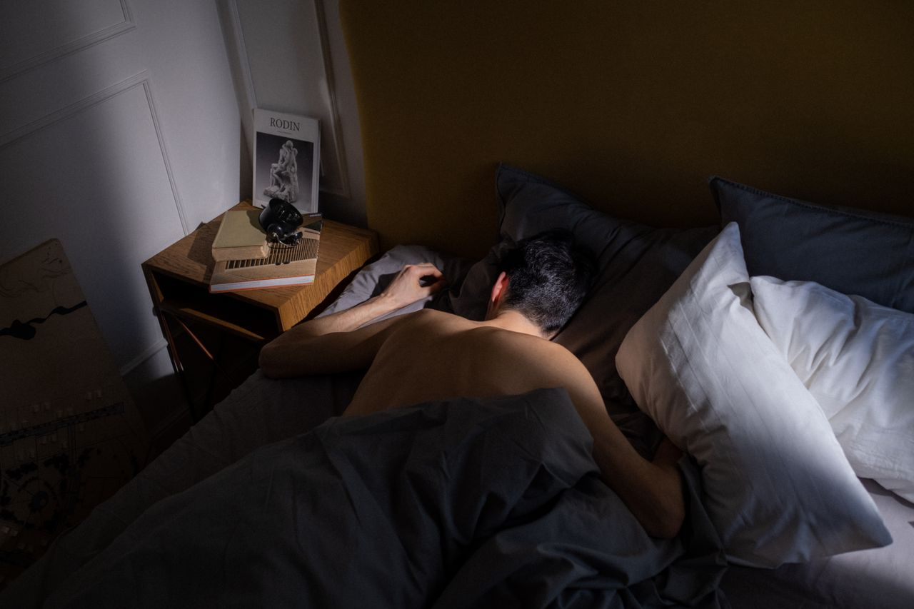
Why You
Are Always Tired
Grades 7–9
Together For Health

Slide 2
73%
of Canadian teens do not get enough sleep on school nights
Chronic sleep deprivation in teens is now considered a public health crisis by the American Academy of Pediatrics.
Together For Health

Slide 3
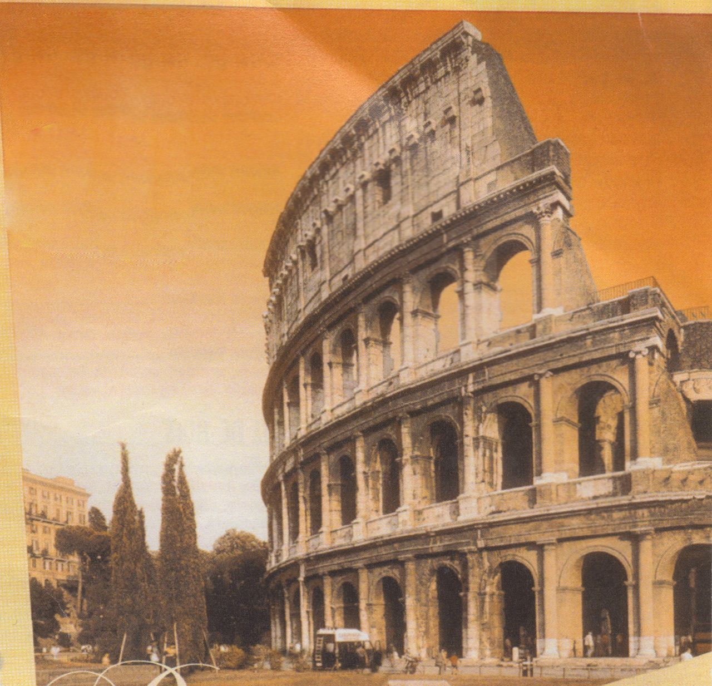
🔬
The Biology of Teen Sleep
Circadian rhythm shifts during puberty — biologically inclined to sleep and wake later
Melatonin release in teens starts ~2 hours later than in adults or kids
Most schools start when teen biology says it is still night
Sleep pressure (adenosine) builds more slowly in teens — need more time awake to get tired
This is not laziness — it is neurobiology
Together For Health

Slide 4
📱
Why Phones Are Destroying Your Sleep
Blue light from screens suppresses melatonin production by up to 50%
Social media creates anxiety and FOMO that activates stress response
Dopamine from notifications keeps brain in alert state
Average teen checks their phone 30× during the night
Solution: charge phone outside your bedroom — non-negotiable
Together For Health

Slide 5
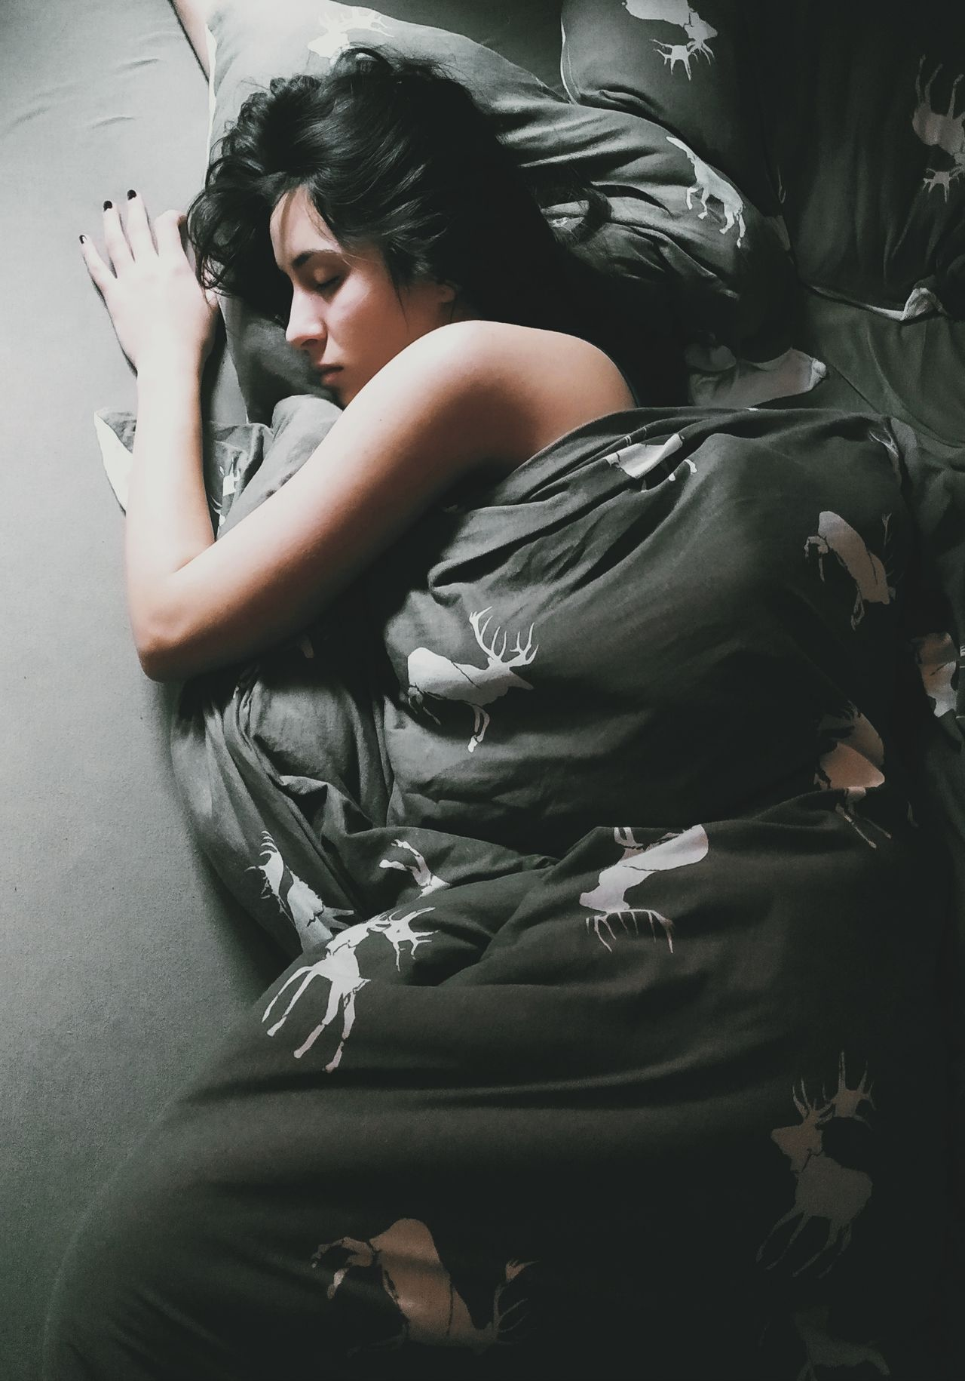
🛌
Sleep Hygiene — The Evidence-Based Routine
Consistent wake time — even weekends (most important factor)
1
No screens 60 min before bed — use Night Shift / blue light glasses
2
Cool room: 65–68°F / 18–20°C is ideal for sleep
3
Darkness triggers melatonin — blackout curtains, eye mask
4
Wind-down ritual: 20 min of reading, stretching, or breathing exercises
5
Together For Health

Slide 6
🧠
Sleep and Academic Performance
Students who sleep 8+ hours consistently score 15–20% higher on tests.
Sleep is when long-term memories are consolidated. Pulling an all-nighter before an exam is counterproductive.
Together For Health

Slide 7
KEY TAKEAWAYS
Sleep is an active biological process — your body does its best work then
✓
Consistent sleep schedule beats any supplement or biohack
✓
Protect your sleep like the priority it is — academic performance depends on it
✓
Resources
Sleep Foundation: sleepfoundation.org
Calm App: free sleep meditations
Talk to your doctor if you consistently cannot sleep
Together For Health

